Slide 2
BG: what is input data
1 plots Az vs time + temps over 10 min for few + elvation
cal num of lines and time leap for one month
3 overview slides
how line of sight to zenith

Slide 3
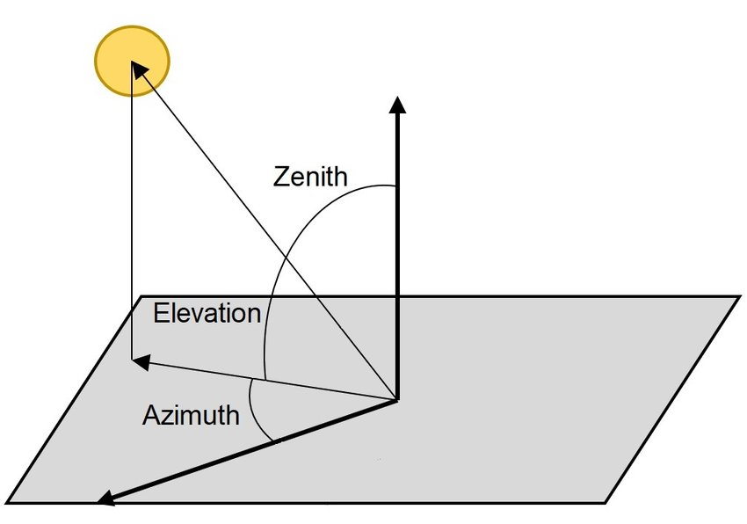
What I used in data
TIME …… TSRC0 TSRC1 TSRC2 TSRC3 EL AZ
2024-06-12T19:01:36.642127 …… 64.9747390747 34.9560852051 21.7463874817 16.6668453217 55.0 2.625
TIME
TSRC0 TSRC1 TSRC2 TSRC3 : the observing temperature
EL
AZ

Slide 4
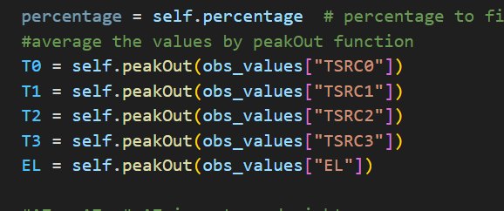
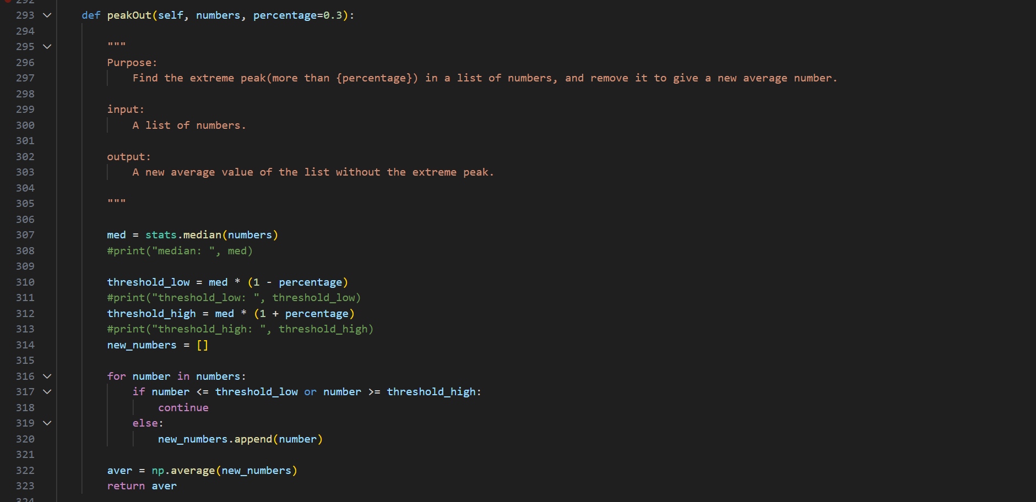
How avg

Slide 5
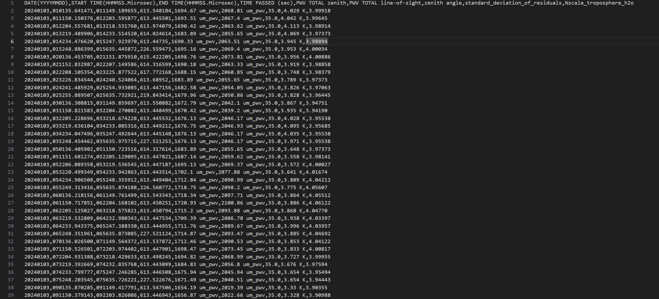

Slide 6
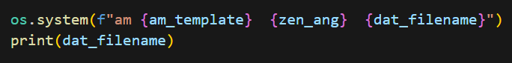
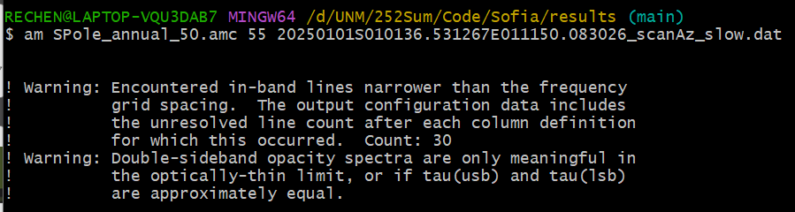
am fitting
=
The first warning seems to happen mostly in the mesosphere and stratosphere, rather than in the troposphere. Therefore, the pwv should have a very low influence.
The second warning is about the output tau, which we did use.

Slide 7
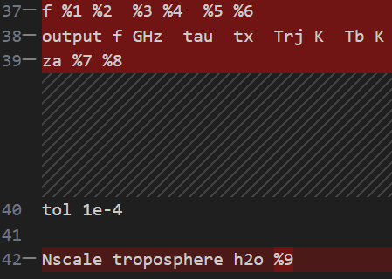
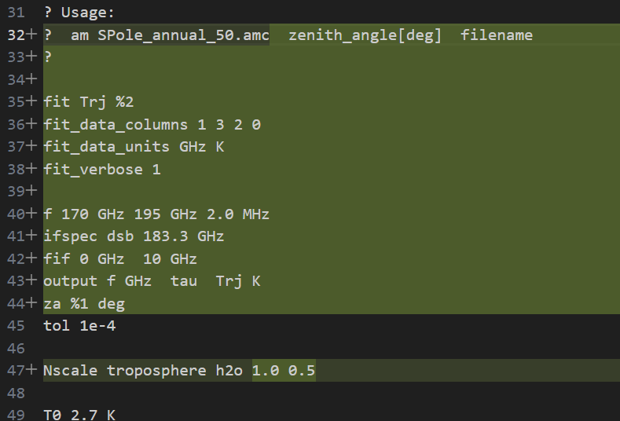
What’s the different of am fitting file
From am Cookbook
From Sofia’s code GitHub:
WVR-pipeline/ Templates/SPole_annual_50.amc

Slide 8
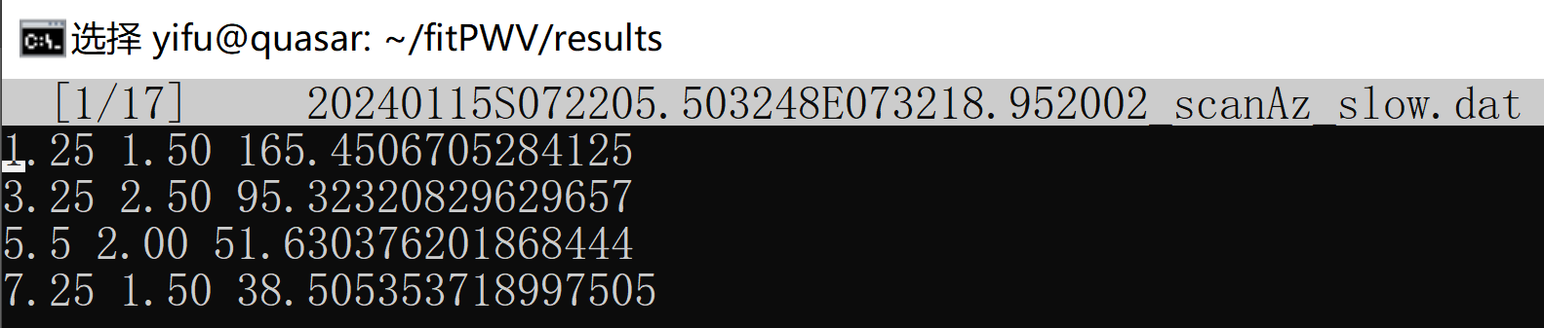

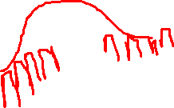
am fitting
From amc, we expect the dat file as
frequence(v_i) bandwith(b_i) spectral data (s_i)
So, the dat is means:
observing 184.55(183.3 + 1.25) GHz, the bandwidth is 1.50 GHz, spectral data is the observing temperature

Slide 9
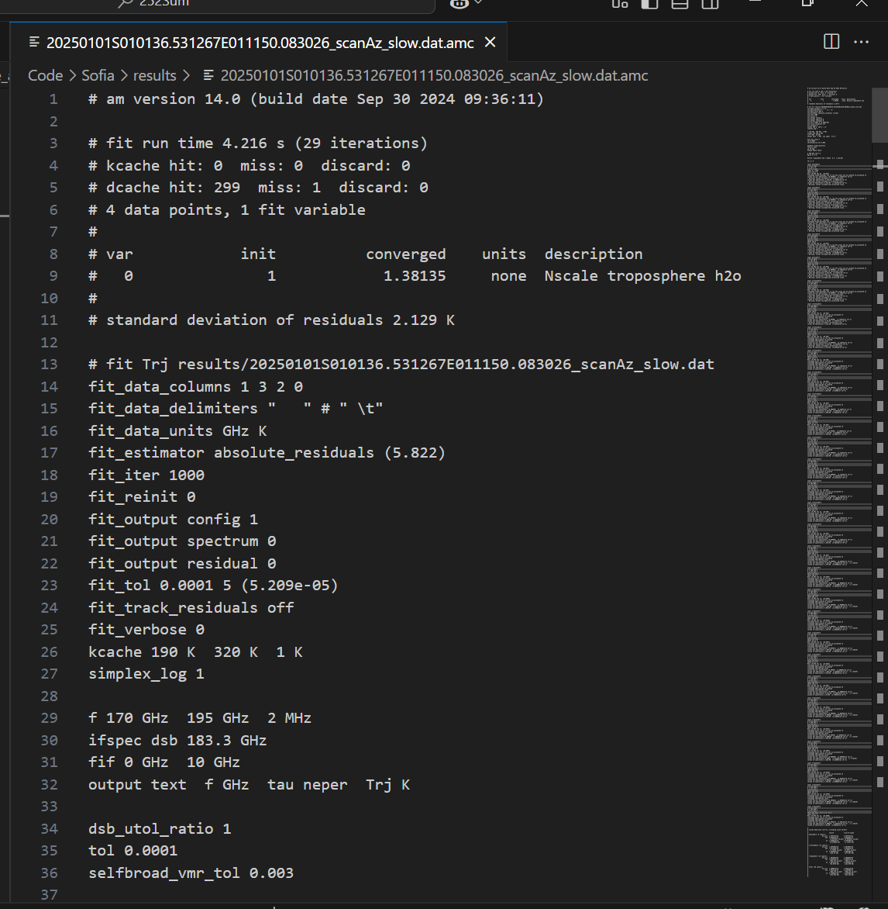
Output amc file

Slide 10
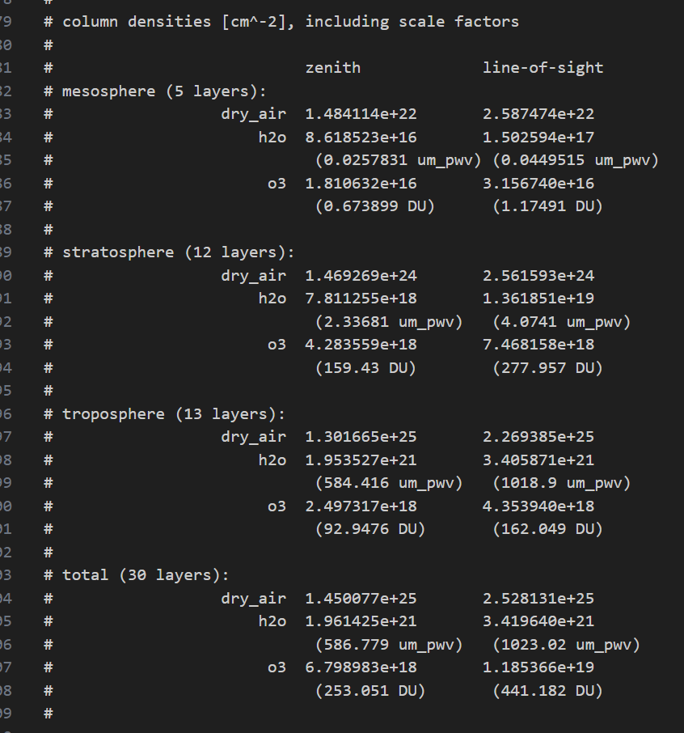
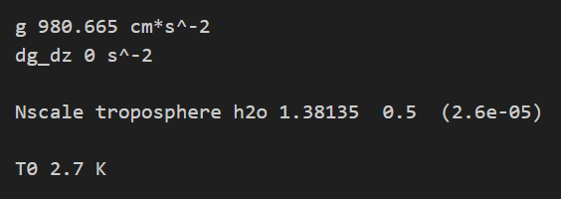
Output amc file

Slide 11
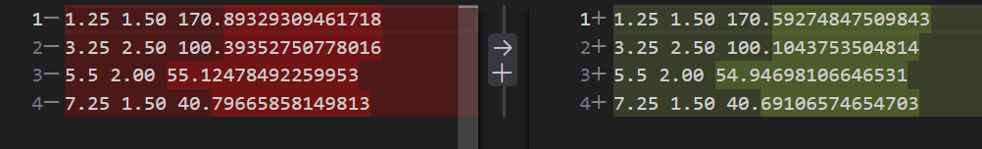
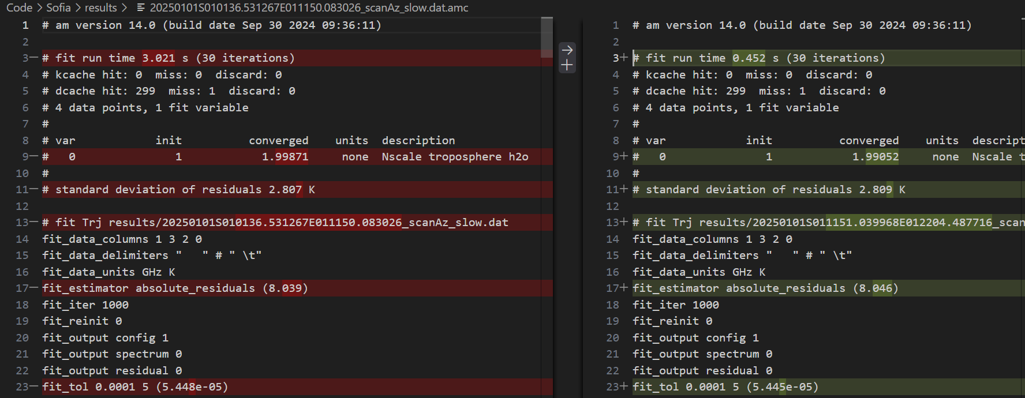
Compare Data 20250101 010136.531267 to 011150.083026 and 20250101 011151.039968 to 012204.487716
The output amc different:

Slide 12
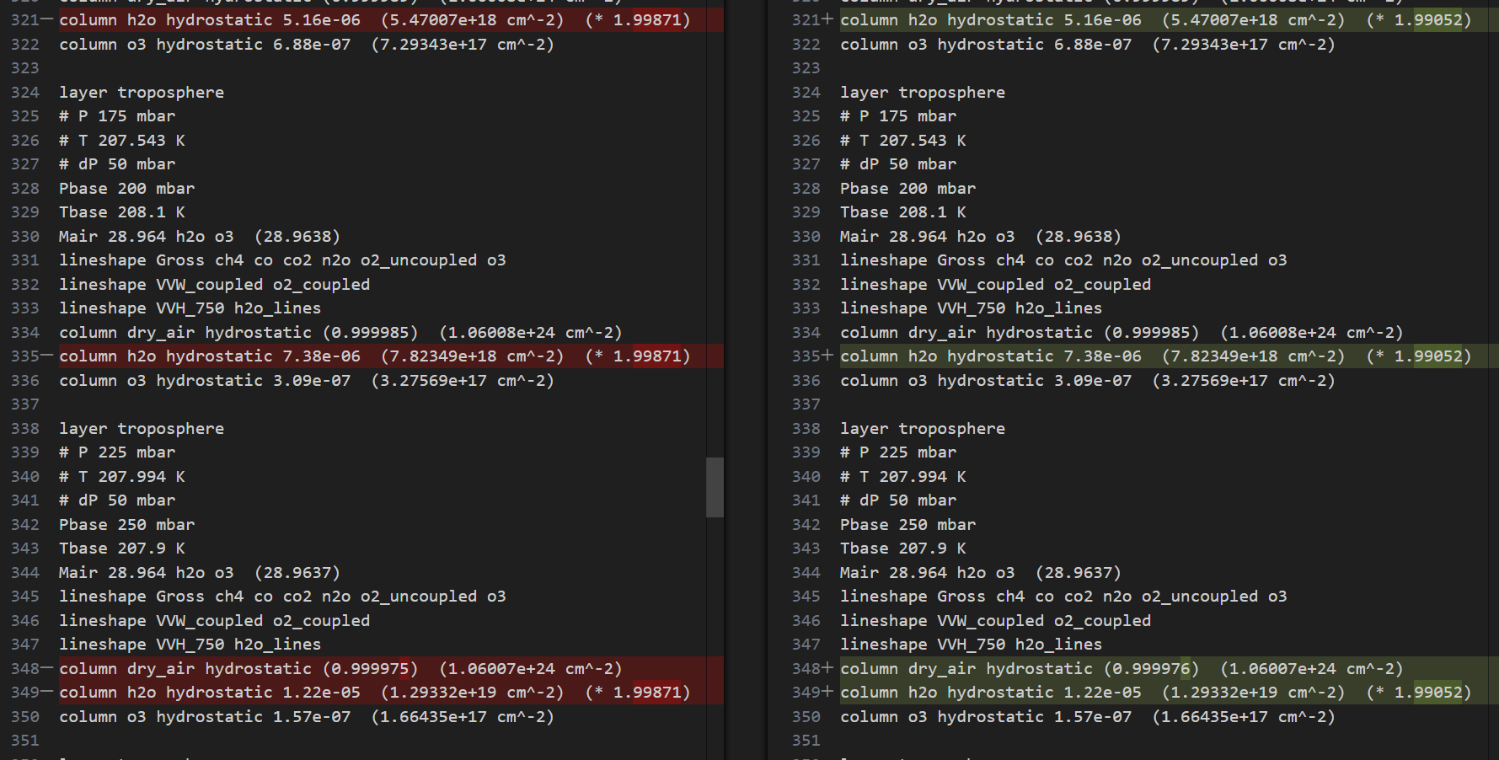

Slide 13
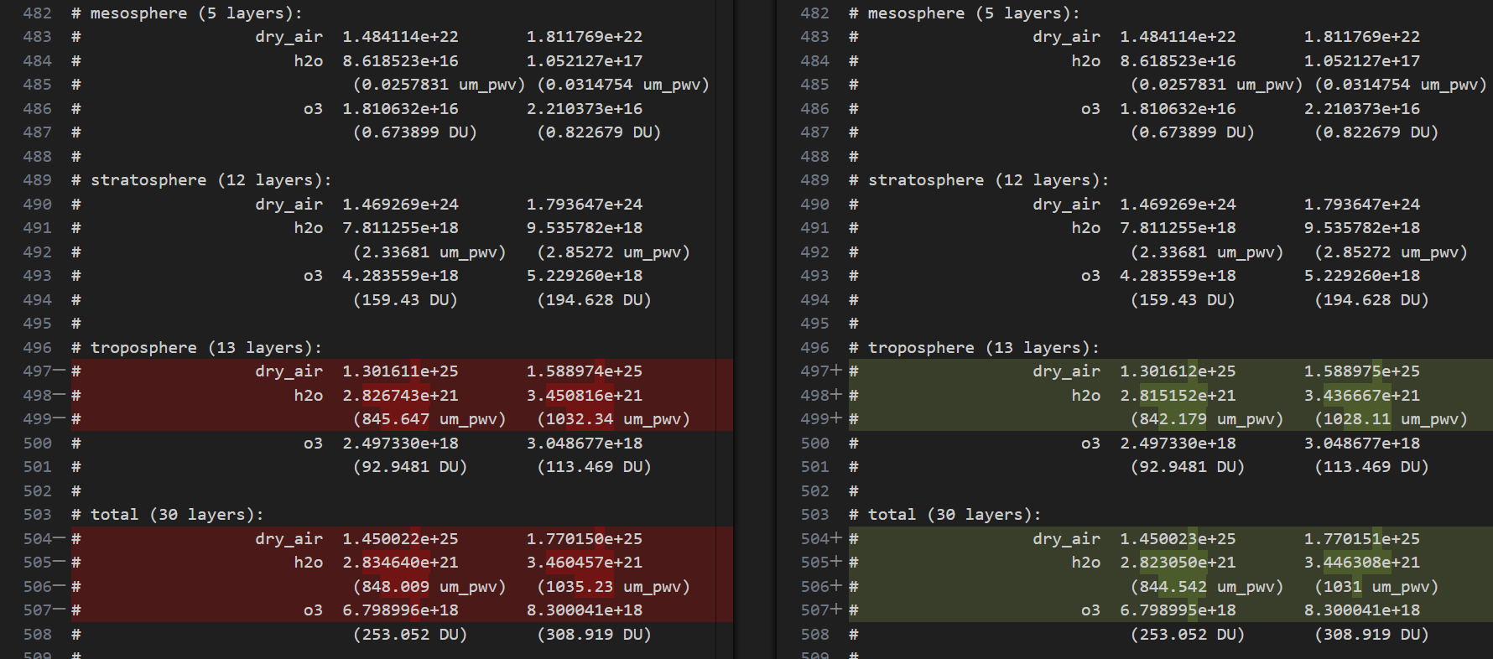

Slide 14
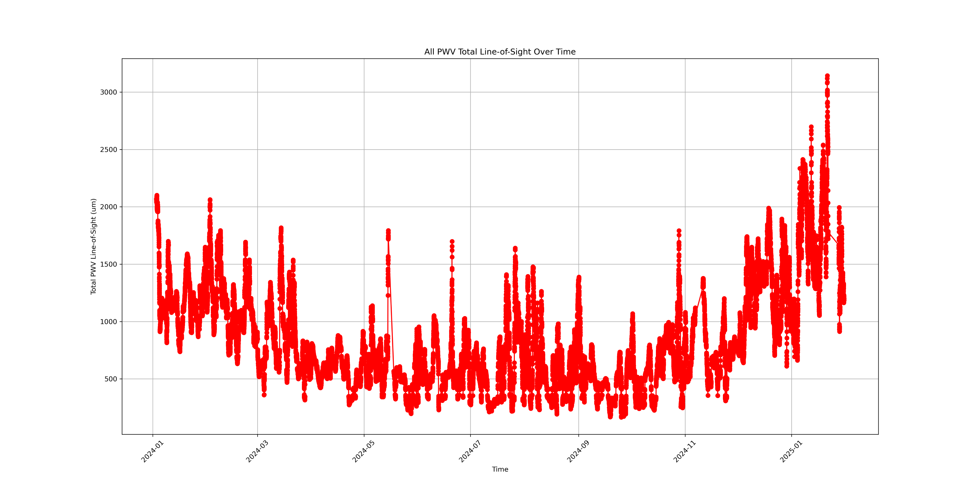

Slide 15
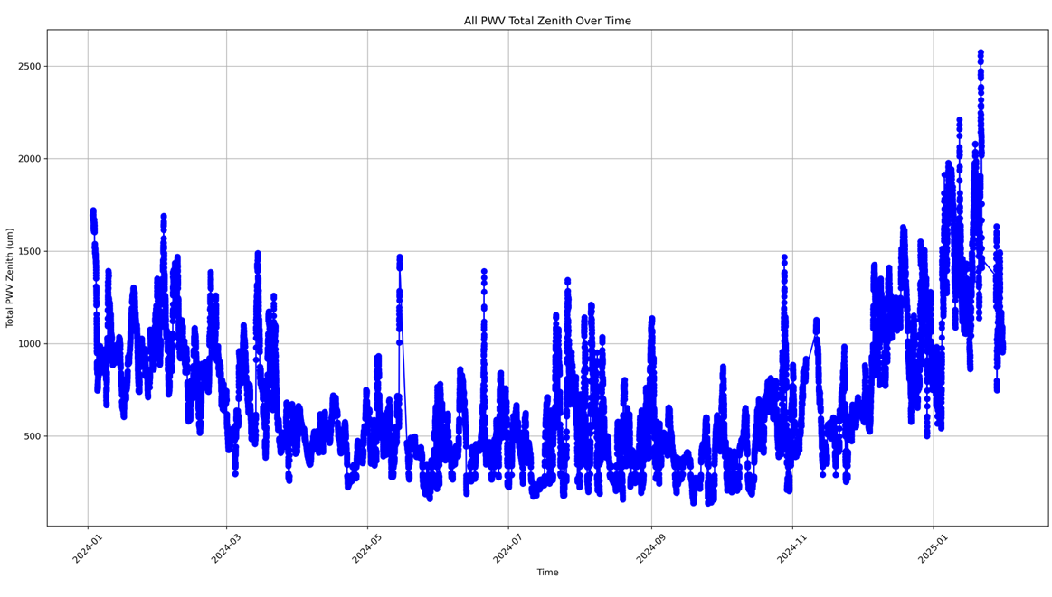

Slide 16
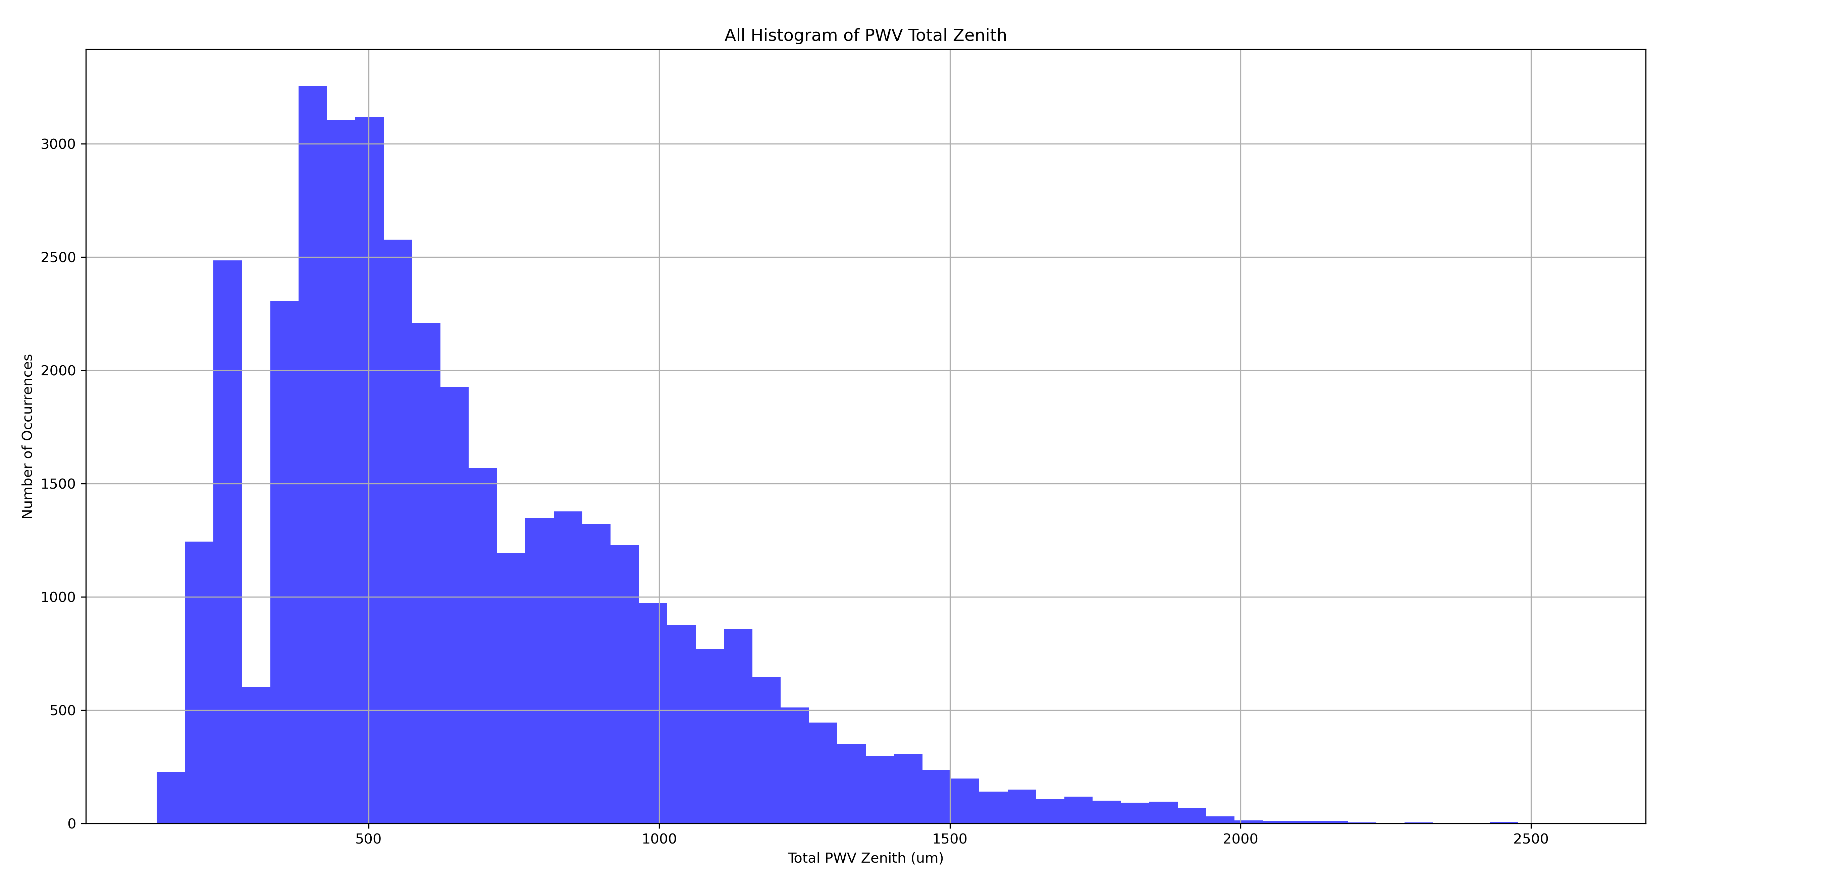

Slide 17
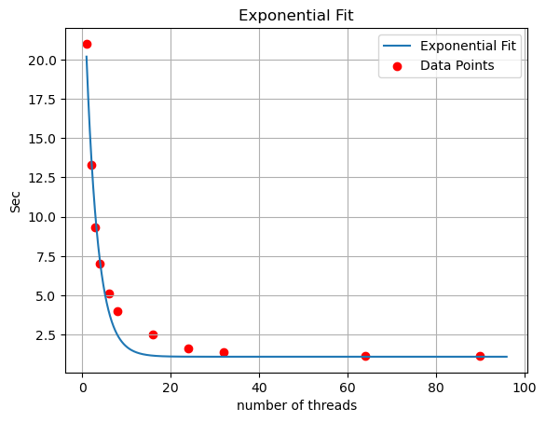

Slide 18
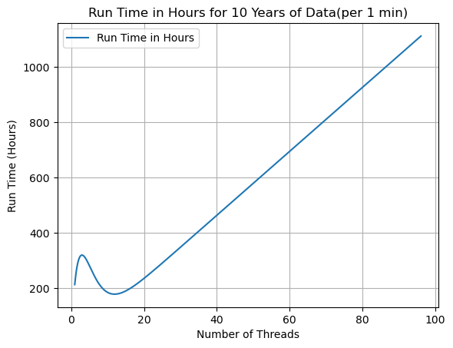

Slide 19
